Slide 1
COMP90007 Internet Technologies Workshop
Week 10 – Application Layer
Ruixi
huor@student.unimelb.edu.au

Slide 2
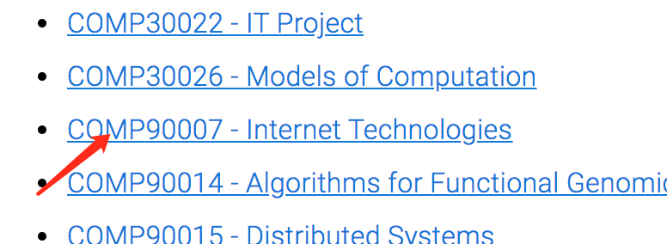
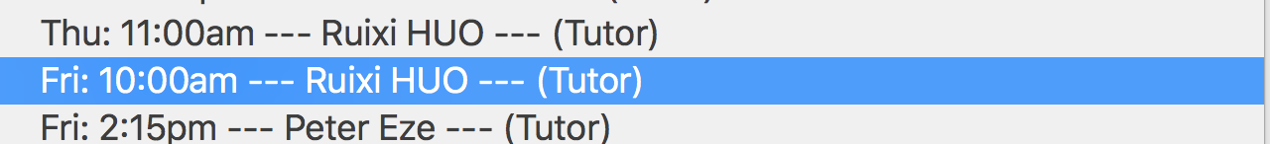
Fill in the survey
https://apps.eng.unimelb.edu.au/casmas/index.php?r=qoct/subjects

Slide 3
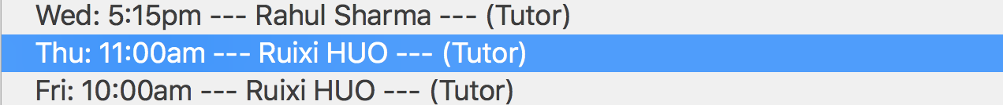
Fill in the survey
https://apps.eng.unimelb.edu.au/casmas/index.php?r=qoct/subjects

Slide 4
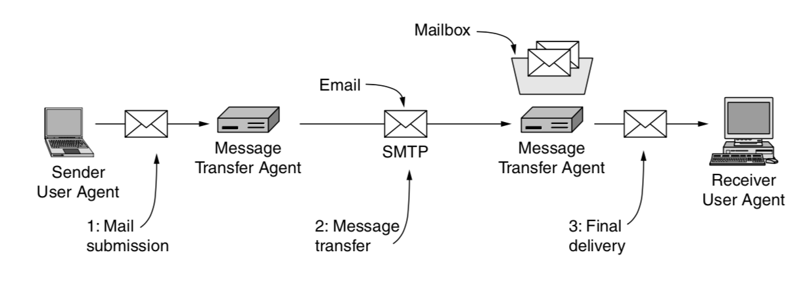
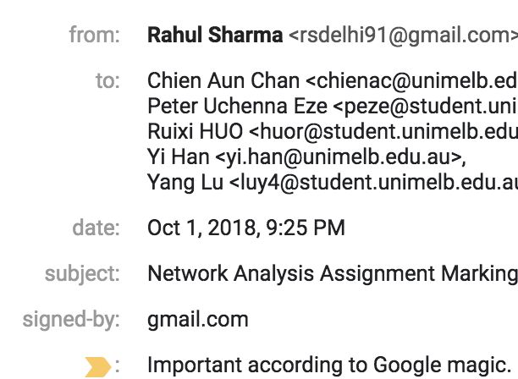
Architecture of the email system
mailing lists
Gmail
Outlook
Gmail
Outlook
It consists of two kinds of subsystems:
user agents – a program, which allow people to read and send email
message transfer agents (mail servers) – system processes, which move the messages from the source to the destination.

Slide 5
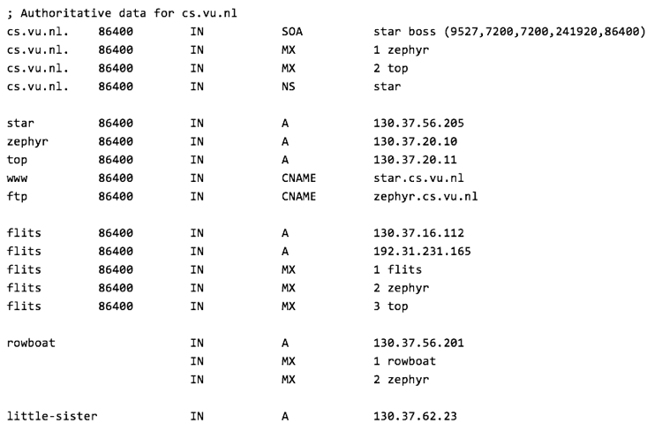
mailing lists
Gmail
Outlook
Gmail
Outlook
Mail is sent between MTAs
in a standard format.

Slide 6
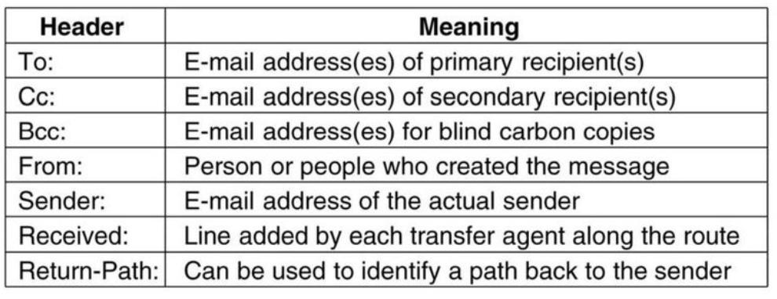
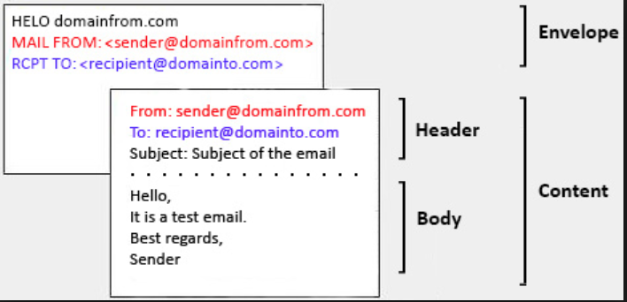
Message Format: RFC 5322
envelope
It contains all the information needed for transporting the message
header
content
body

Slide 7
mailing lists
Gmail
Outlook
Gmail
Outlook
Mail is sent between MTAs
in a standard format.
Final Delivery
In this case, the job of the user agent is to present a view of the contents of the mailbox, and to allow the mailbox to be remotely manipulated.
There are several protocols can do this
IMAP, POP3

Slide 8
POP3 (Post Office Protocol version 3)
Communicate with the MTA and download the emails to a local user client like Gmail, Outlook
Mail is usually downloaded to the user agent computer, instead of remaining on the mail server.
POP3 is a one-way communication protocol, which means that data is pulled from the remote server and sent to the local client.
IMAP (Internet Message Access Protocol)
POP3
daemon
POP3
program

Slide 9
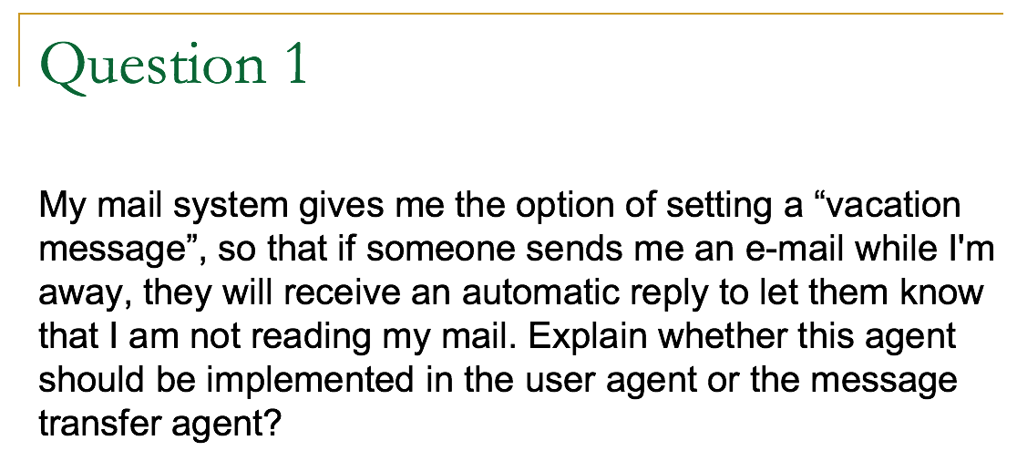
Answer:
It should be implemented in the message transfer agent, since the user agent is unlikely to be left running while the user is on holidays.

Slide 10
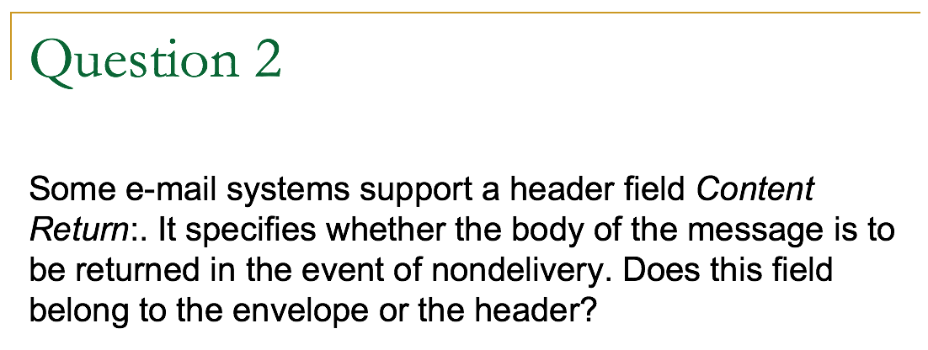
Answer:
It belongs to the envelope because the delivery system needs to know its value to handle e-mail that cannot be delivered.

Slide 11
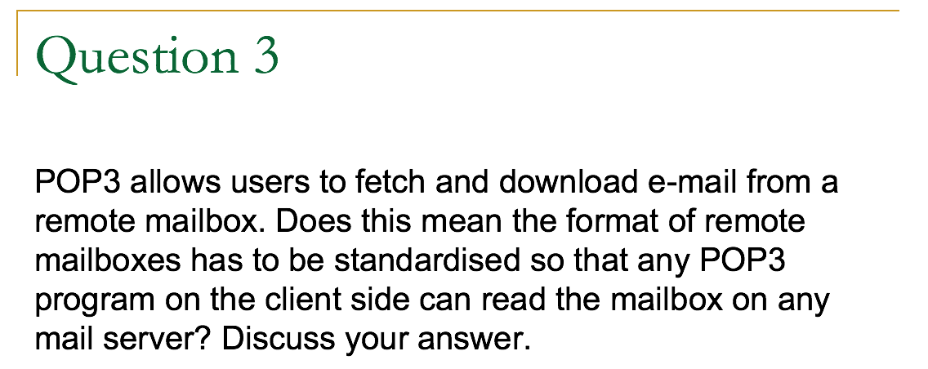
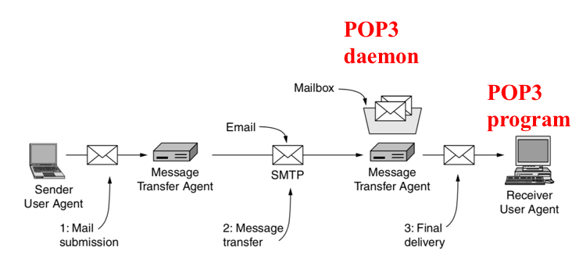
No.
The POP3 program does not actually touch the remote mailbox. It sends commands to the POP3 daemon on the mail server. As long as that daemon understands the mailbox format, it can work.
Thus, a mail server could change from one format to another overnight without telling its customers, as long as it simultaneously changes its POP3 daemon so it understands the new format.
Notes:
Daemon: a program runs in the background, waiting to be activated by certain command or condition.

